Slide 1
CNN
Marlabs

Slide 2
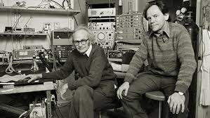
Convolutional Neural Networks
Just like the simple perceptron, CNNs also have their origins in biological research.
Hubel and Wiesel studied the structure of the visual cortex in mammals, winning a Nobel Prize in 1981.

Slide 3
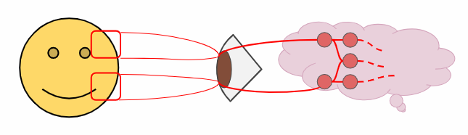
Convolutional Neural Networks
Their research revealed that neurons in the visual cortex had a small local receptive field.

Slide 4
Convolutional Neural Networks
This idea then inspired an ANN architecture that would become CNN
Famously implemented in the 1998 paper by Yann LeCun et al.
The LeNet-5 architecture was first used to classify the MNIST data set.

Slide 5
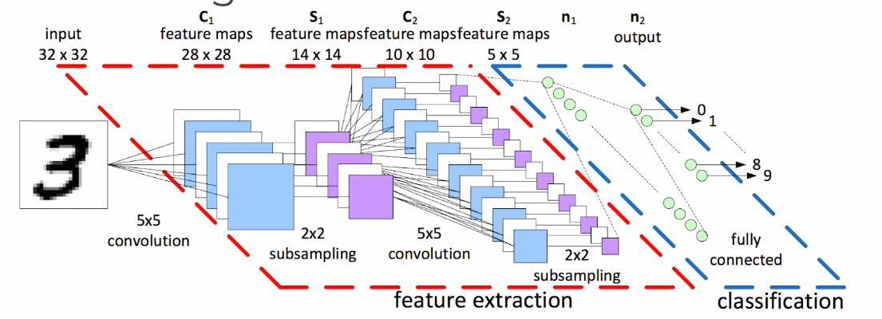
Convolutional Neural Networks
When learning about CNNs you’ll often see a diagram like this:

Slide 6
CNN
Let’s break down the various aspects of a CNN seen here:
Tensors
DNN vs CNN
Convolutions and Filters
Padding
Pooling Layers
Review Dropout

Slide 7
CNN
Recall that Tensors are N-Dimensional Arrays that we build up to:
Scalar - 3
Vector - [3,4,5]
Matrix - [ [3,4] , [5,6] , [7,8] ]
Tensor - [[ [ 1, 2] , [ 3, 4] ],
[[ 5, 6] , [ 7, 8]]]

Slide 8
CNN
Tensors make it very convenient to feed in sets of images into our model - (I,H,W,C)
I : Images
H: Height of Image in Pixels
W: Width of Image in Pixels
C: Color Channels: 1-Grayscale, 3-RGB

Slide 9
CNN
Now let’s explore the difference between a Densely Connected Neural Network and a Convolutional Neural Network.
Recall that we’ve already been able to create DNNs with tf.estimator API.

Slide 10
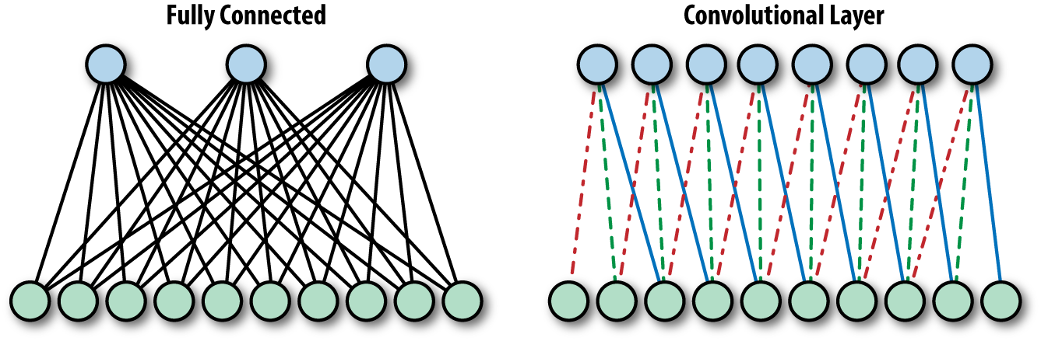
Densely Connected layer (fully connected layer) VS. Convolutional Layer
Convolutional Layer:
Each unit is connected to a smaller number of nearby units in next layer.
So why bother with a CNN instead of a DNN?
The MNIST dataset was 28 by 28 pixels (784 total)
But most images are at least 256 by 256 or greater, (<56k total)!
This leads to too many parameters, unscalable to new images.

Slide 11
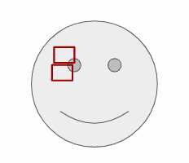
CNN-Advantages
Convolutions also have a major advantage for image processing, where pixels nearby to each other are much more correlated to each other for image detection.
Each CNN layer looks at an increasingly larger part of the image.
Having units only connected to nearby units also aids in invariance.
CNN also helps with regularization, limiting the search of weights to the size of the convolution.

Slide 12
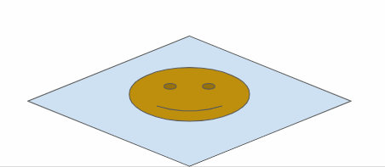
CNN – Image Recognition
Let’s explore how the convolutional neural network relates to image recognition!
We start with the input layer, the image itself.

Slide 13
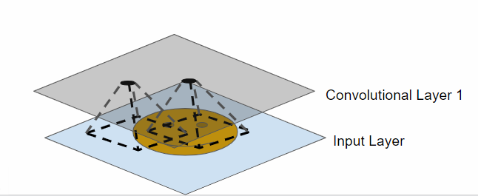
CNN
Convolutional layers are only connected to pixels in their respective fields.

Slide 14
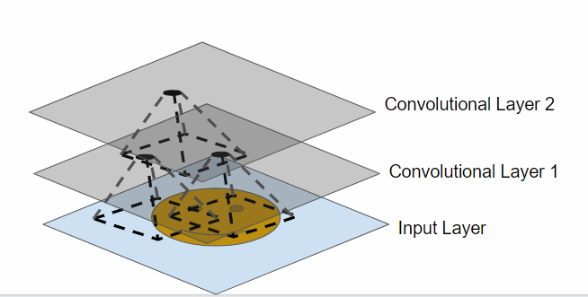
CNN
Convolutional layers are only connected to pixels in their respective fields.

Slide 15
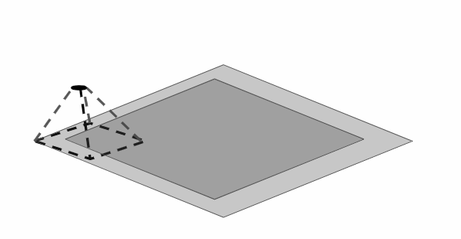
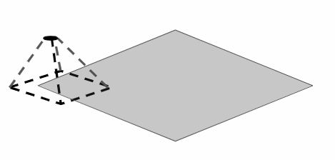
CNN
We run into a possible issue for edge neurons! There may not be an input there for them.
We can fix this by adding a “padding” of zeros around the image.

Slide 16
CNN
Let’s walk through 1-D Convolution in more detail, then expand this idea to 2-D Convolution.
Let’s revisit our DNN and convert it to a CNN.

Slide 17
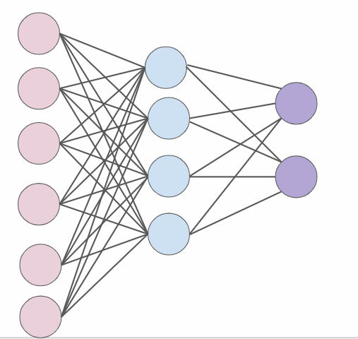
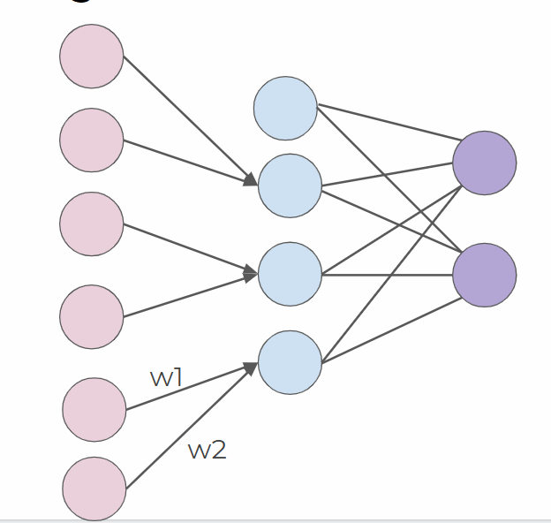
1-D Convolution Walk Through
A DNN
1-D Convolution
We can treat these weights as a filter.

Slide 18
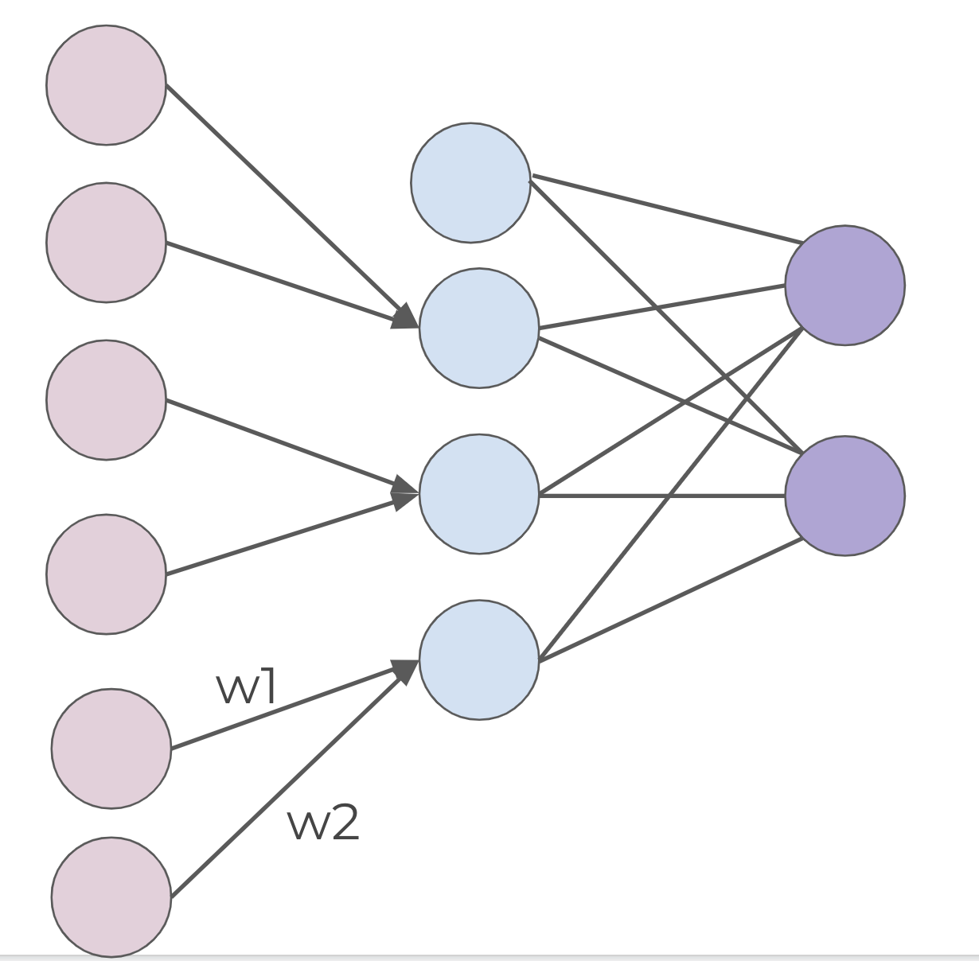
1-D Convolution Walk Through
y = w₁x₁ + w₂x₂
If (w_{1,}w₂) = (1,-1) Then y = x₁ - x₂
When is y at a maximum?
(x_{1,}x₂) = (1,0)

Slide 19
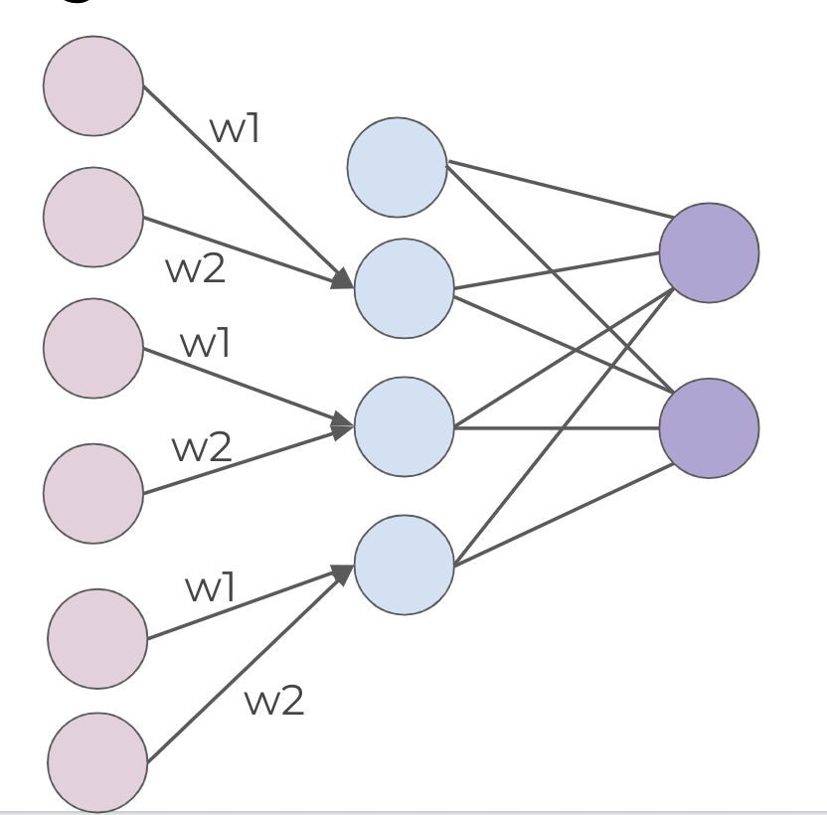
1-D Convolution Walk Through
We now have a set of weights that can act as a filter for edge detection!
We can then expand this idea to multiple filters.

Slide 20
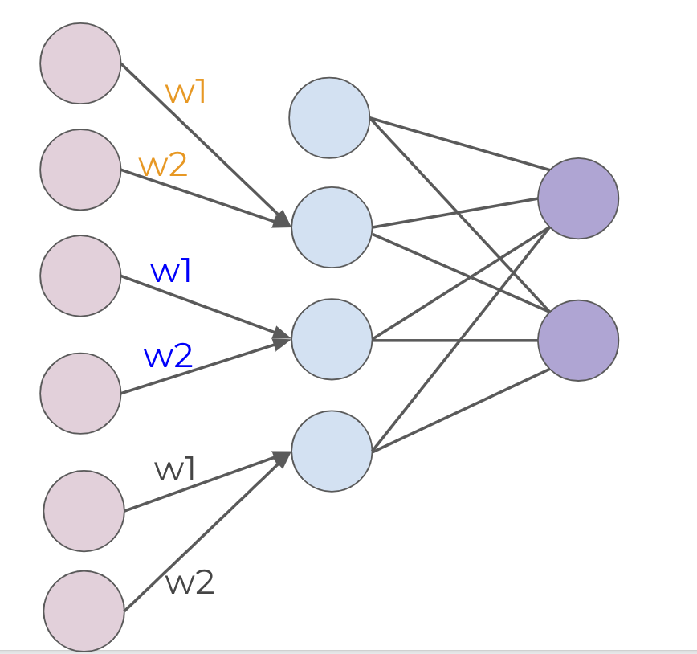
1-D Convolution Walk Through
Filters: 1
Filter Size: 2
Stride: 2

Slide 21
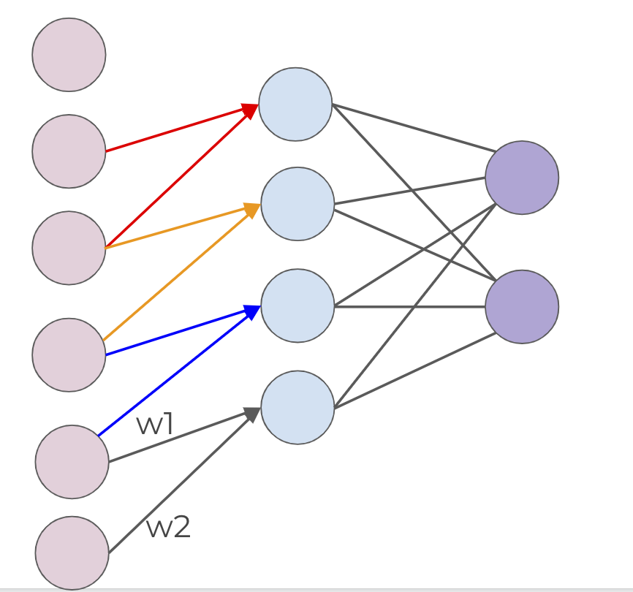
1-D Convolution Walk Through
Filters: 1
Filter Size: 2
Stride: 1 (1 Unit at a time)

Slide 22
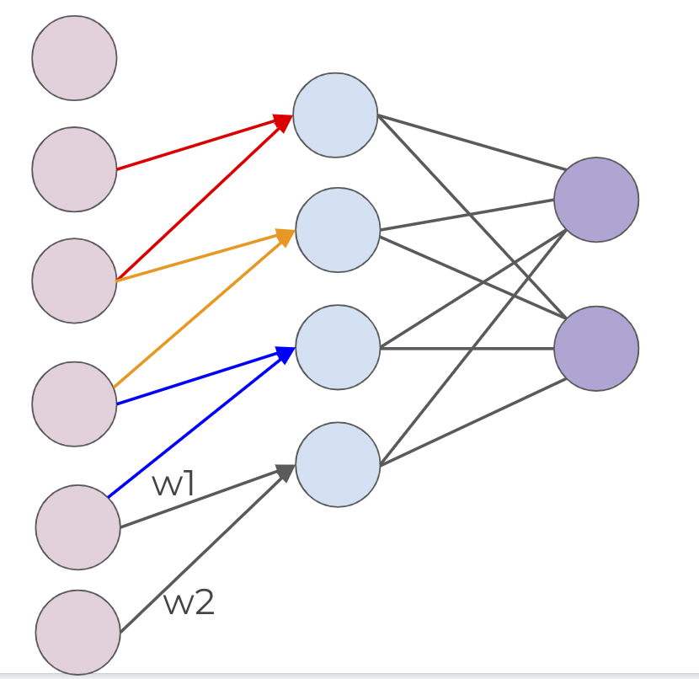
1-D Convolution Walk Through
Remember that we can add zero padding to include more edge pixels.

Slide 23
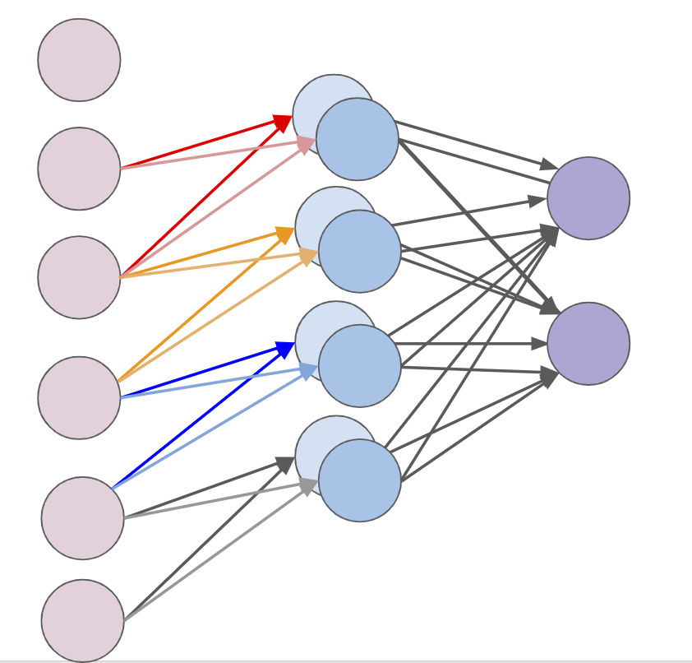
1-D Convolution Walk Through
Filters: 2
Filter Size: 2
Stride: 1 (1 Unit at a time)

Slide 24
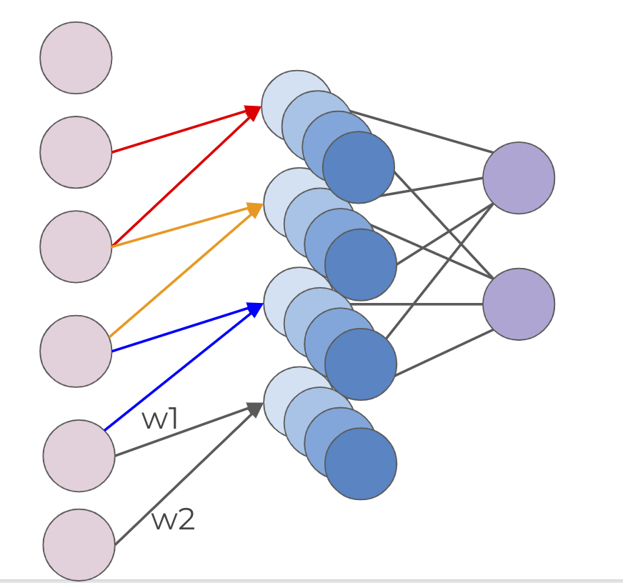
1-D Convolution Walk Through
Filters: 4
Filter Size: 2
Stride: 1 (1 Unit at a time)
Each filter is detecting a different feature

Slide 25
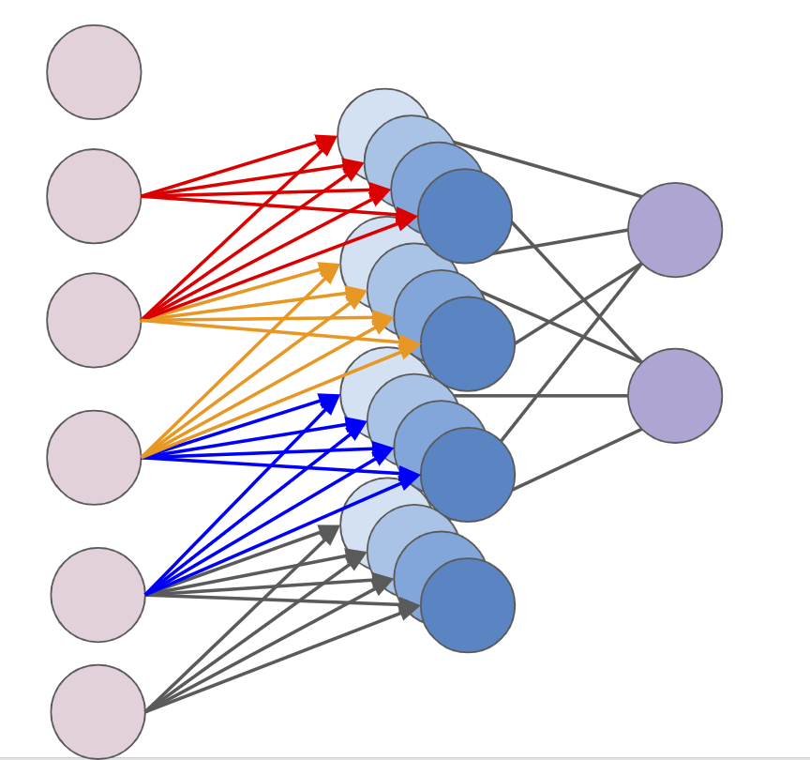
1-D Convolution Walk Through
Filters: 4
Filter Size: 2
Stride: 1 (1 Unit at a time)

Slide 26
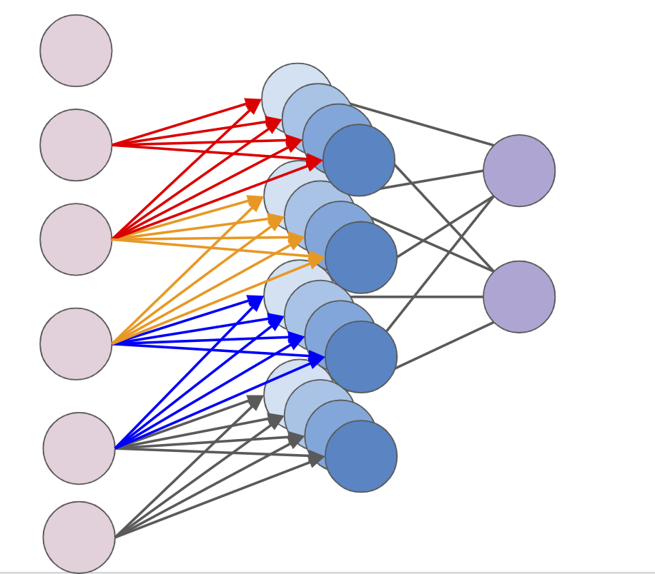
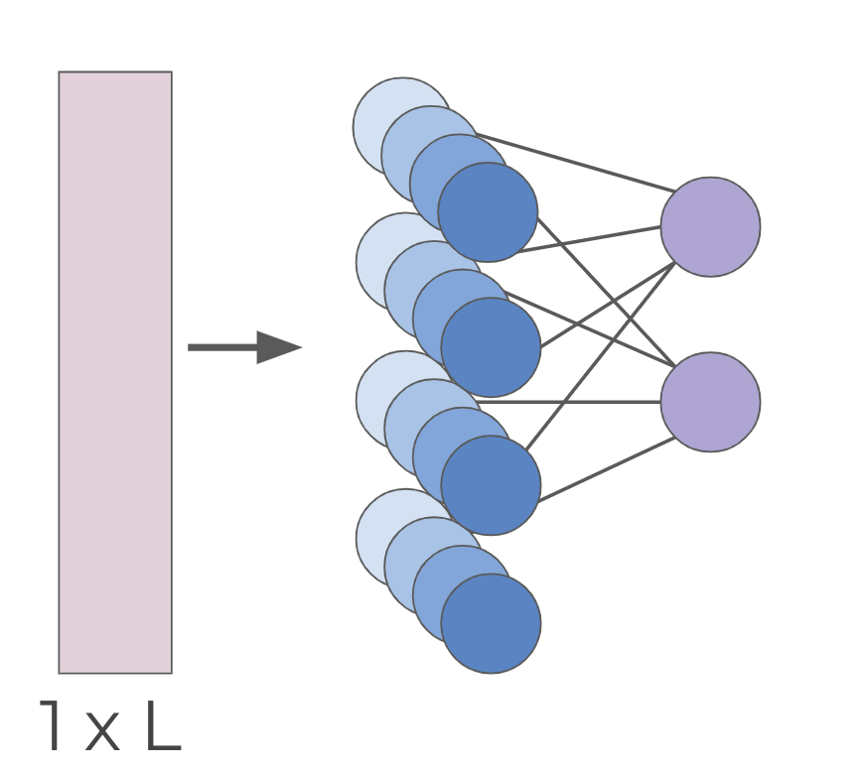
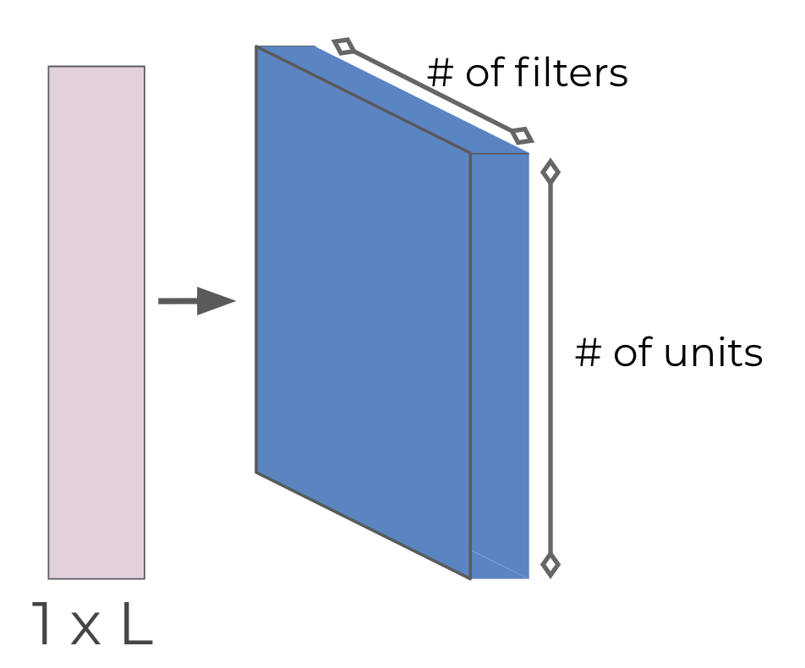
1-D Convolution Walk Through
For simplicity, we begin to describe and visualize these sets of neurons as blocks instead

Slide 27
2-D Convolution
Let’s now expand these concepts to 2-D Convolution, since we’ll mainly be dealing with images.

Slide 28
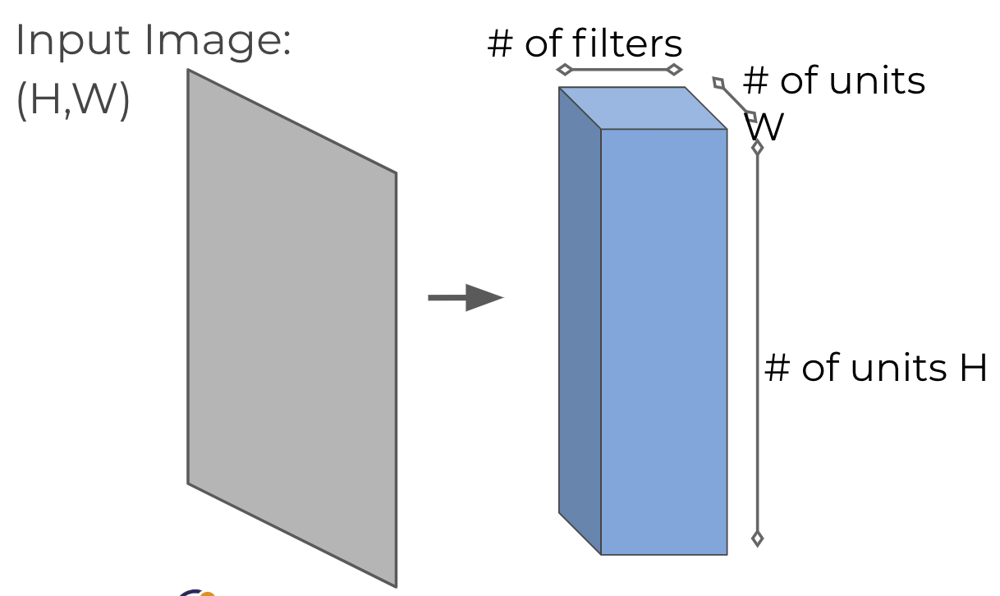
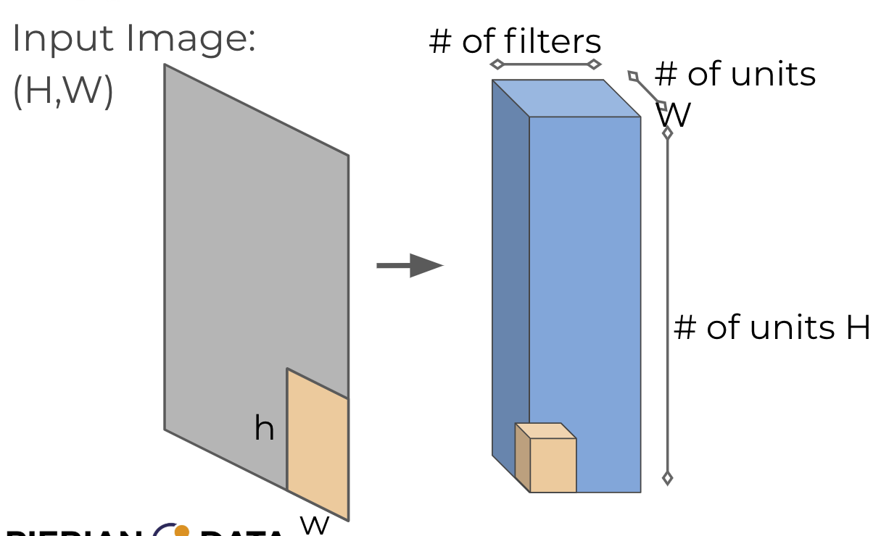
2-D Convolution
w

Slide 29
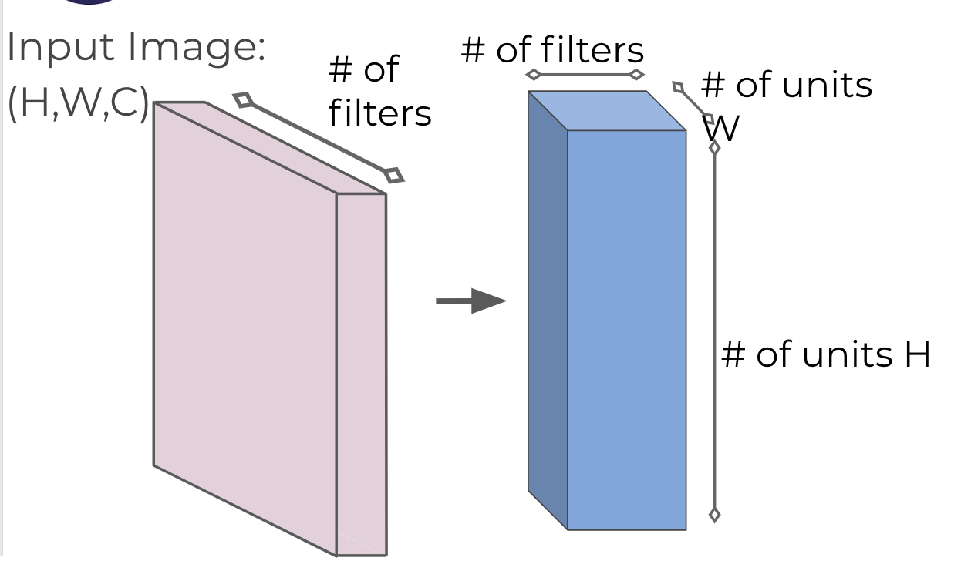
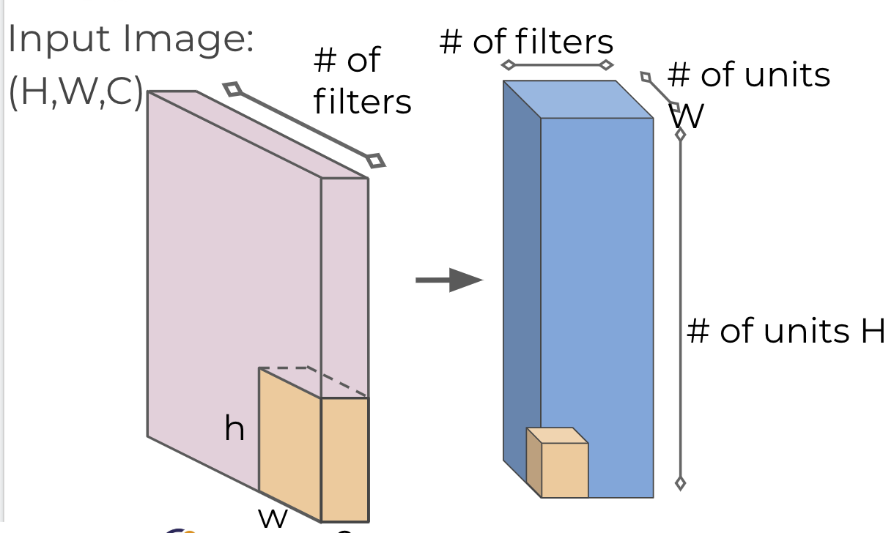
2-D Convolution with Color Images
C

Slide 30
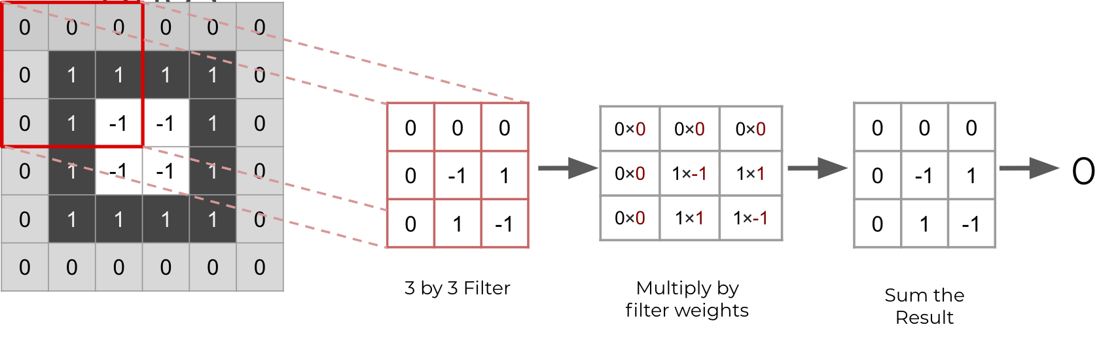
Filters are commonly visualized with grids.

Slide 31
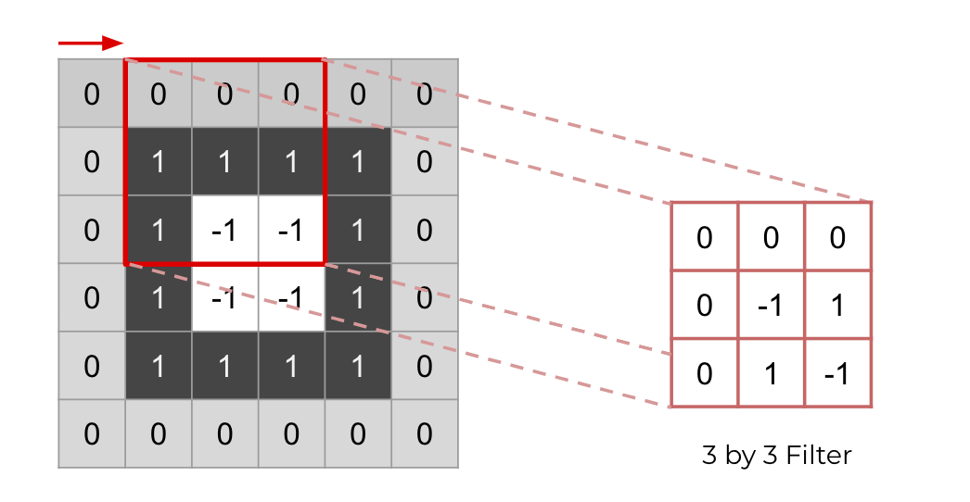
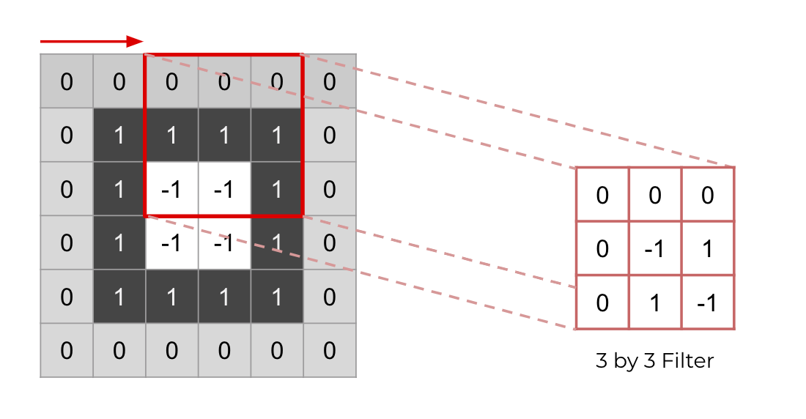
Stride also takes into account how fast you’re going to move across image with your filters.
Stride Distance of 1 Example
Stride Distance of 2 Example

Slide 32
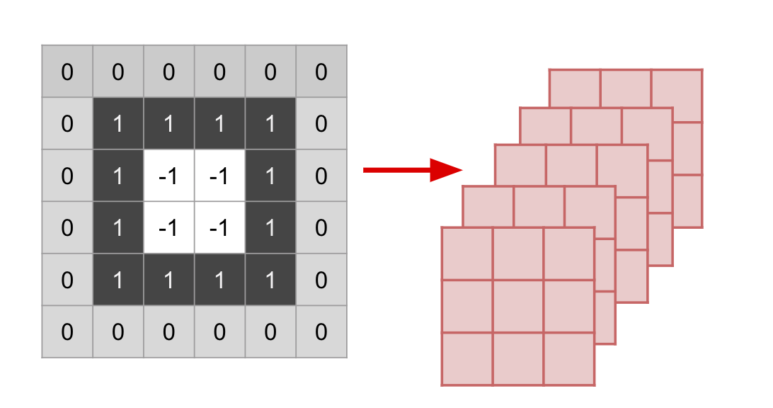
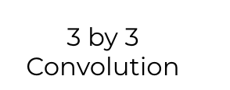
Presentation of Multiple Filters

Slide 33
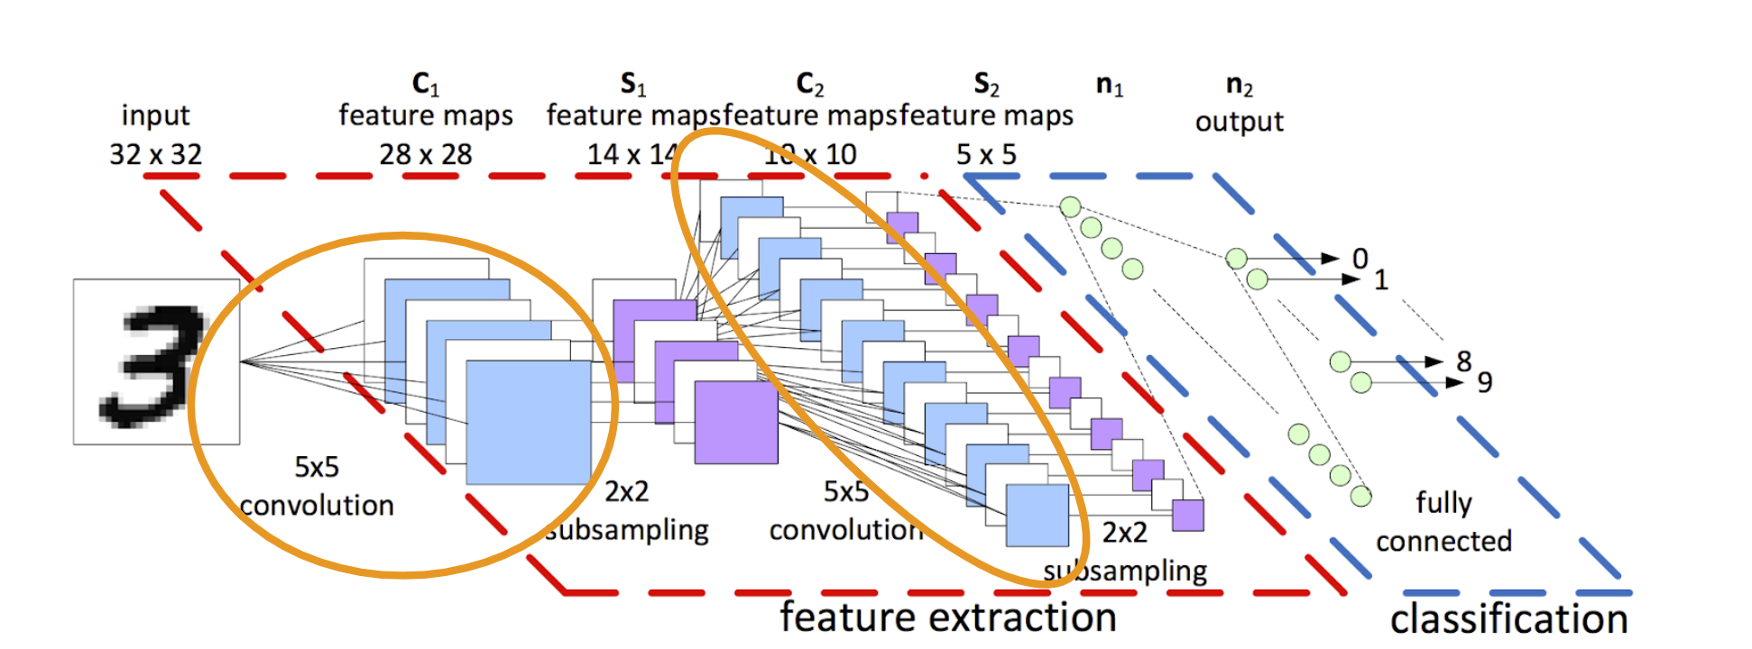
At the original CNN diagram

Slide 34
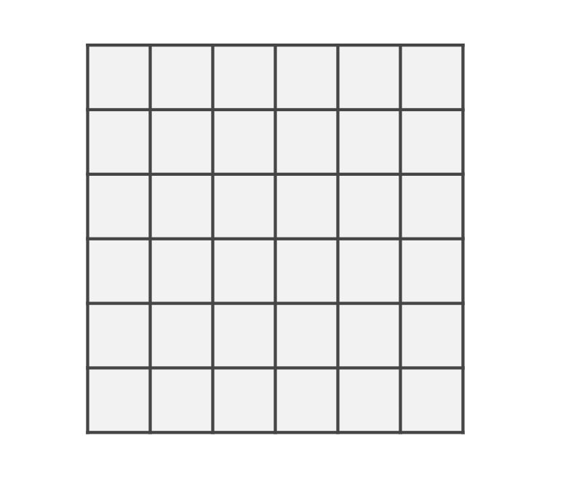
Pooling Layers
Pooling layers will subsample the input image, which reduces the memory use and computer load as well as reducing the number of parameters.
Let’s imagine a layer of pixels in our input image:

Slide 35
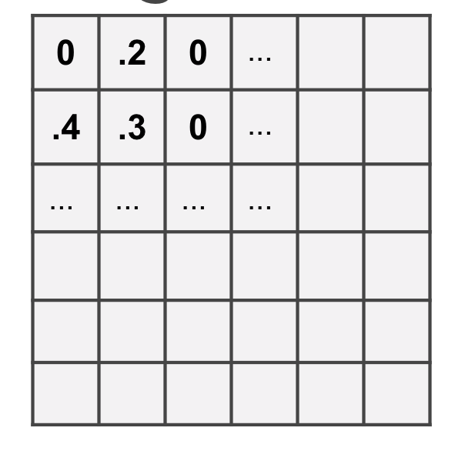
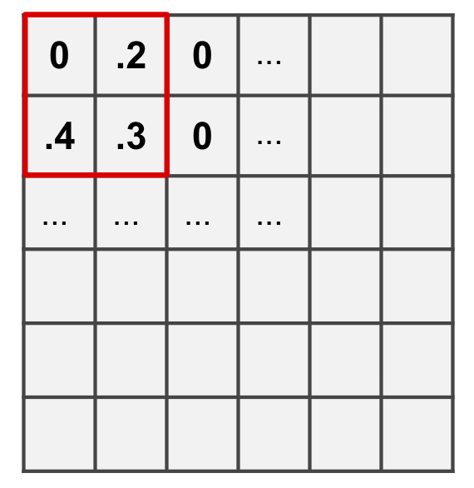
For our MNIST digits set, each pixel had a value representing “darkness”
We create a 2 by 2 pool of pixels and evaluate the maximum value.

Slide 36
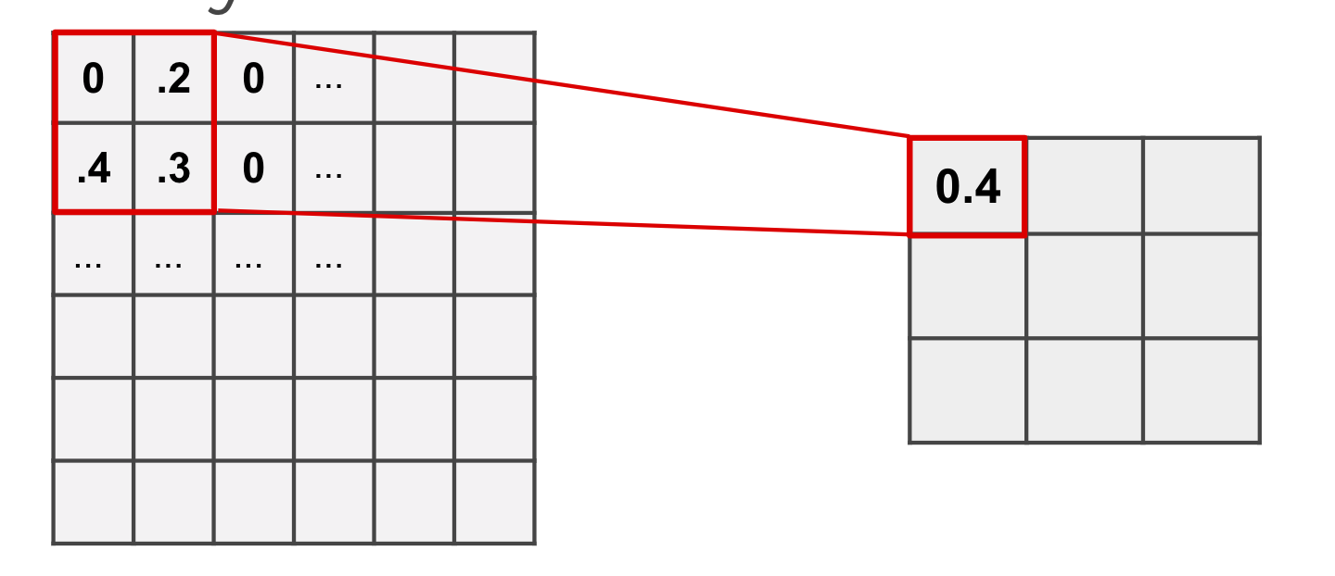
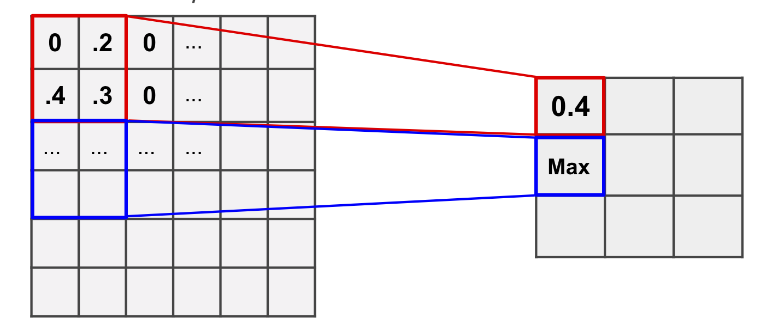
Only the max value makes it to the next layer.
We then move over by a “stride”, in this case, our stride is two.

Slide 37
Pooling Layers
This pooling layer will end up removing a lot of information, even a small pooling “kernel” of 2 by 2 with a stride of 2 will remove 75% of the input data.

Slide 38
Dropout
Dropout can be thought of as a form of regularization to help prevent overfitting.
During training, units are randomly dropped, along with their connections.
This helps prevent units from “co-adapting” too much.

Slide 39
Some Famous CNN architectures
LeNet-5 by Yann LeCun
AlexNet by Alex Krizhevsky et al.
GoogLeNet by Szegedy at Google Research
ResNet by Kaiming He et al.

